Slide 1
Getting Started
GitHub
https://github.com/PalEON-Project/Camp2016
Paleoinformatics
1. Powerpoint PalEON_201608_Informatics….pptx
2. Exercise (HTML) Workshop_PalEON_201608_v0.1.html
3. Exercise (RMD) Workshop_PalEON_201608_v0.1.rmd
Neotoma
4. Explorer - http://apps.neotomadb.org/explorer/
5. APIs - http://api.neotomadb.org/doc/

Slide 2

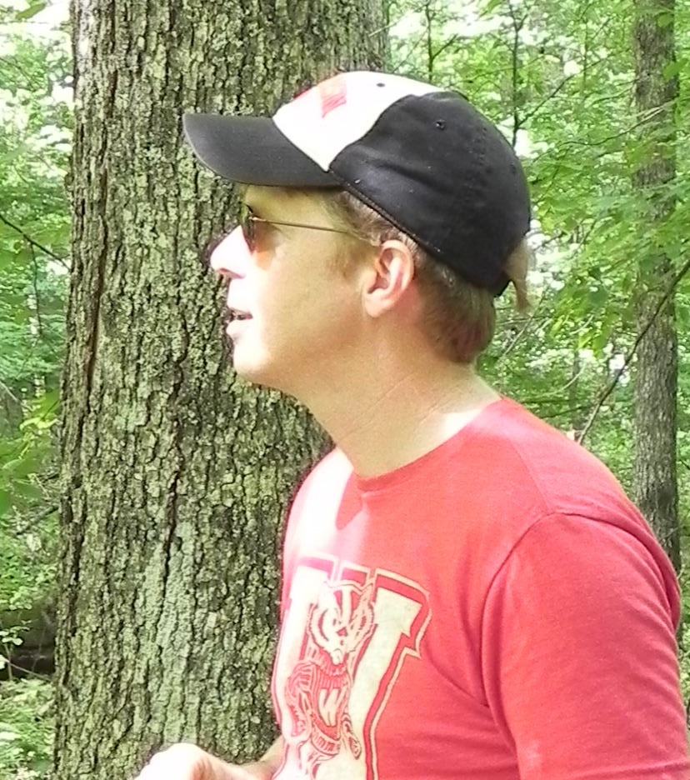
Paleoecoinformatics, Neotoma DB, and Scientific Workflows Jack Williams & Simon Goring
@IceAgeEcologist
@sjGoring
Part 1: Paleoecoinformatics & Community Curated Data Repositories (10 min)
Part 2: Neotoma Paleoecology Database (30 min)
Part 3: Scientific workflows and neotoma (20 min)
Notes:
PREPARATIONS
*Neotoma Explorer webpage
*

Slide 3
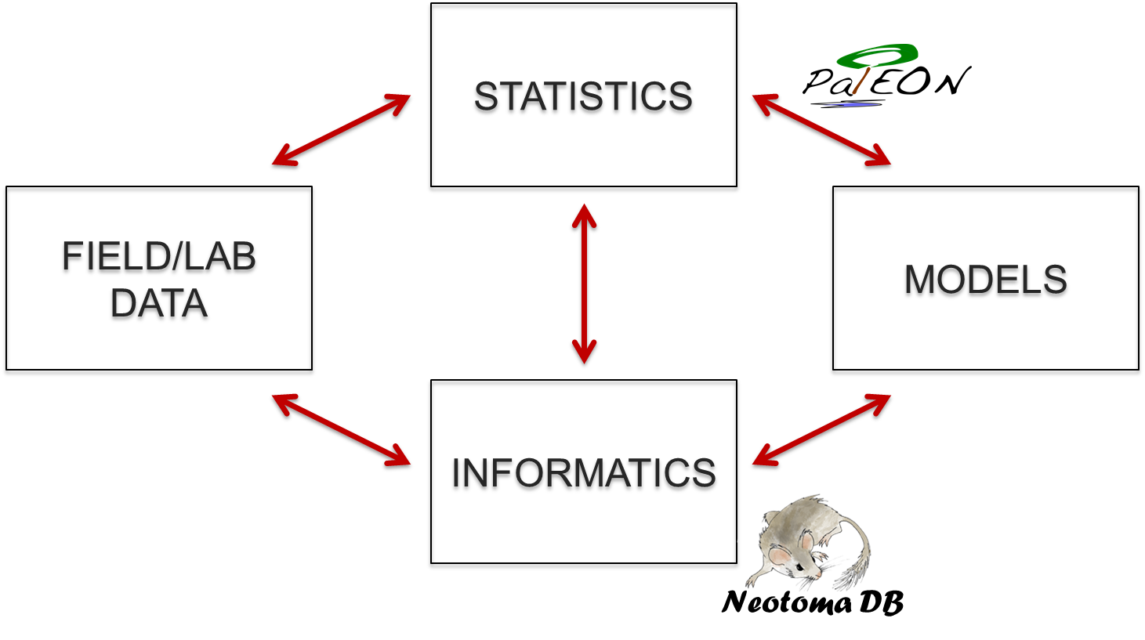
Macro-Scale Ecology Requires requires collaboration among at least four major groups

Slide 4
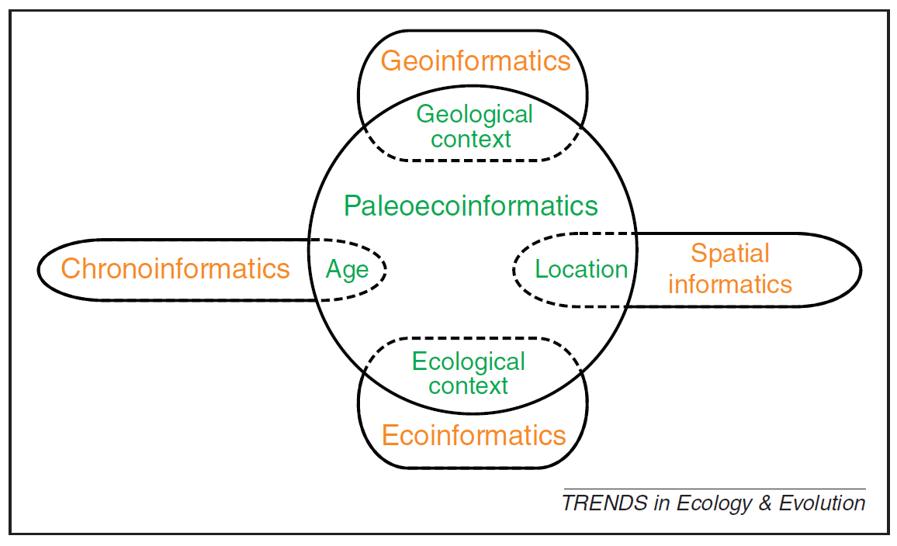
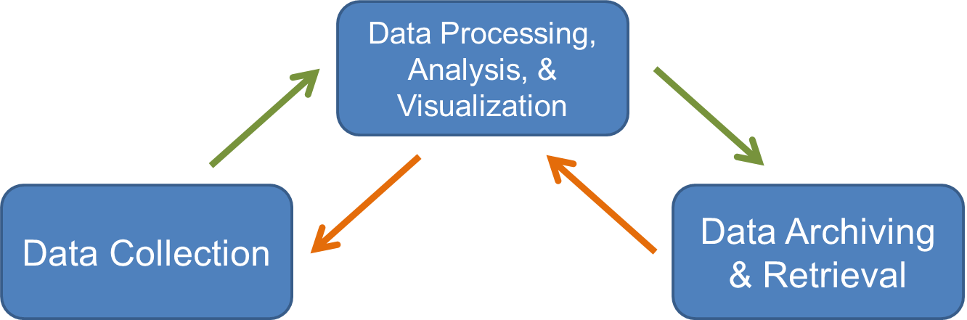
Informatics: designing systems that deliver the right information, to the right person in the right place and time, in the right way. (Wikipedia)
Paleoecoinformatics: the collection, organization, analysis, synthesis, and curation of paleoecological data
Brewer et al. 2012 TREE

Slide 5
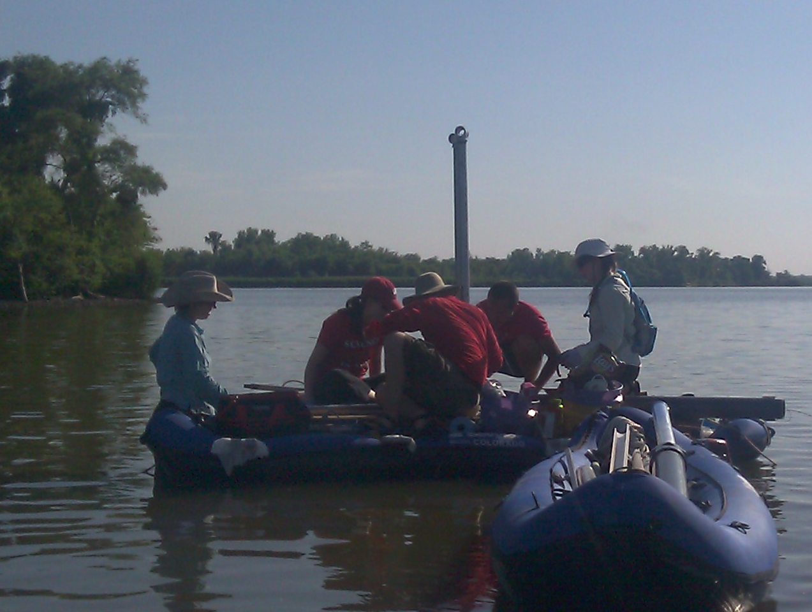
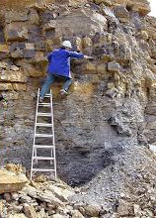
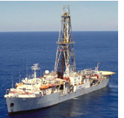
Paleodata: Key characteristics
‘Long Tail’: Collected in the field & lab by many individuals and scientific teams.
Heterogeneity: Many kinds of measurements & methods
Distributed Scientific Expertise by proxy type, archive type, region, time period, and/or taxonomic group
Commonality: All involve measurements of proxies in various geological archives by depth, from which we estimate time.
Long Shelf Life: specimens & samples collected decades ago can be re-analyzed
Bad News
Good News

Slide 6
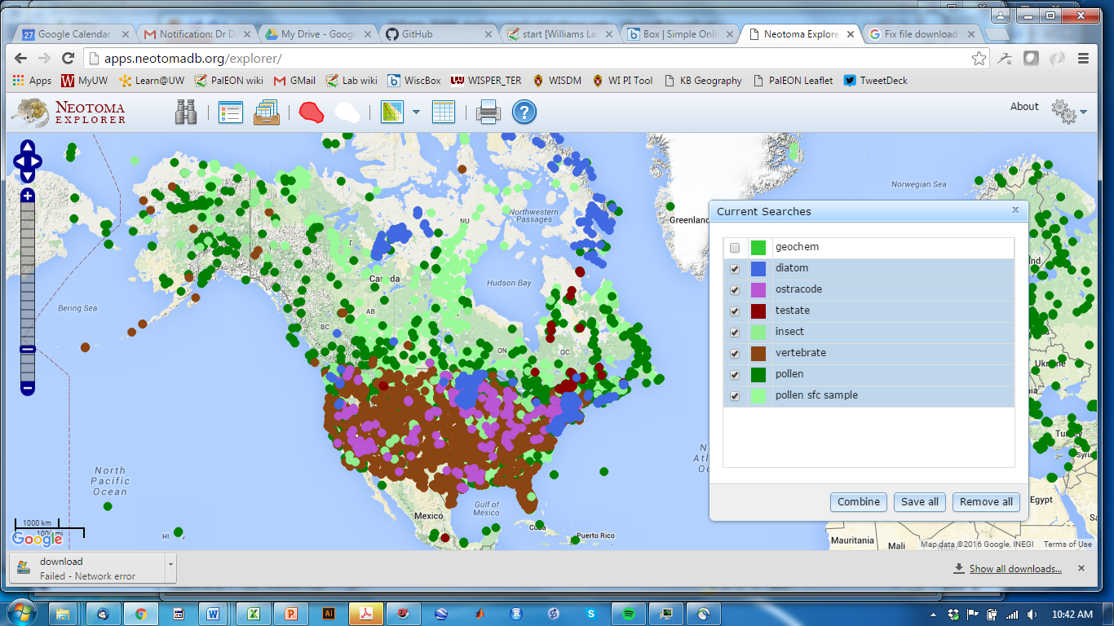
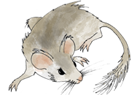
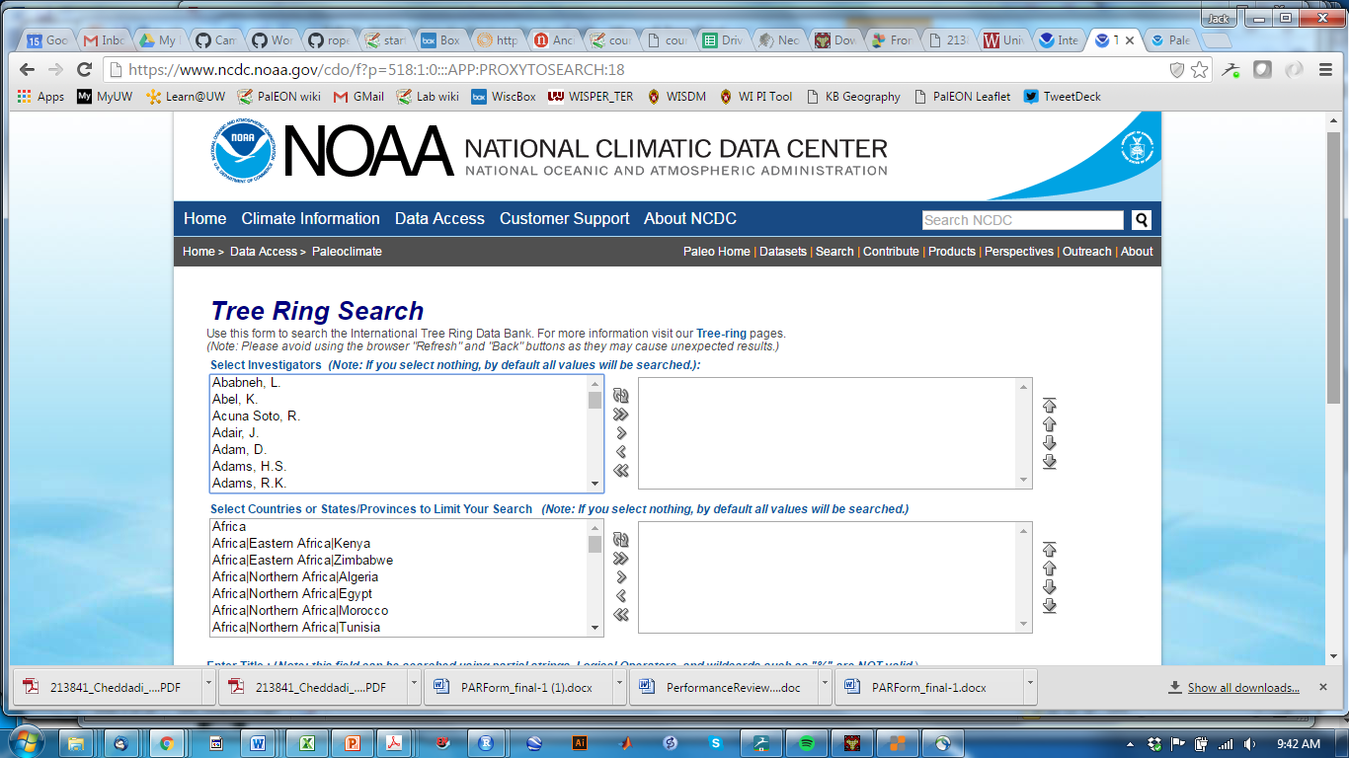
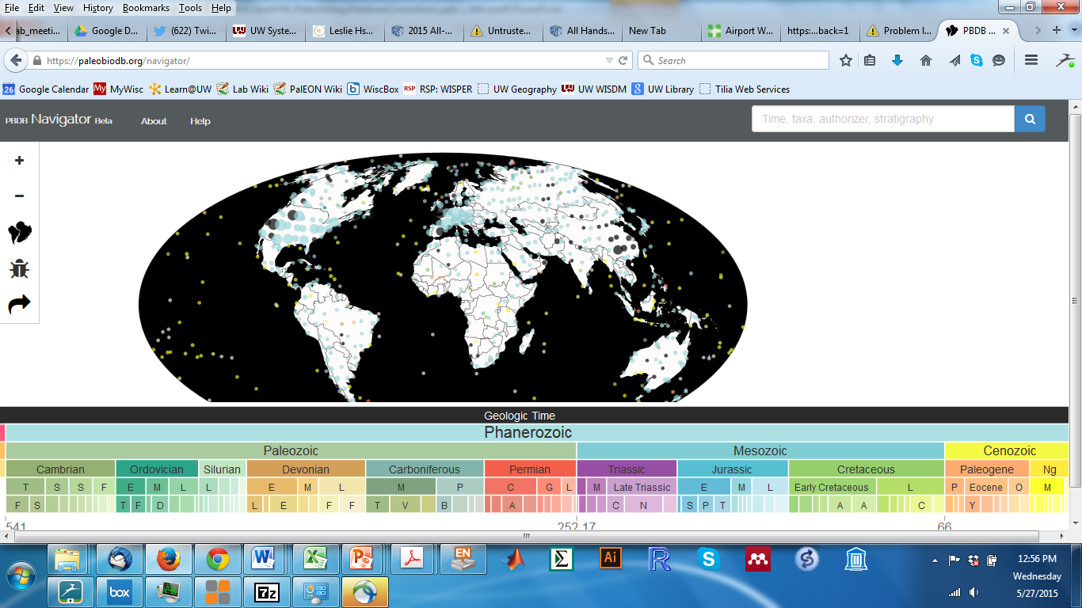
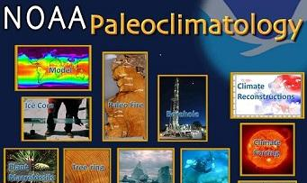
Community Curated Data Repositories (CCDRs) have emerged to tackle macro-scale questions
Characteristics
Open data
Developed by domain scientists
Started to support specific research questions, evolve from there
Add value via discipline-specific metadata, variable names, etc.
Neotoma DB
ITRDB
Paleobiology DB
paleobiodb.org

Slide 7

Moving up the Value Chain: Generic Depositories to Community-Led Repositories
BIG DATA
Community-
Led Repositories
interoperable
harmonized, community governance & input
re-usable
Generic Depositories
context,
provenance
accessible
authorization,
protocols
Neotoma
PBDB
LinkedEarth
findable
identification,
persistence
Data Dryad
FigShare
Journal Data Supplements
small data
Modified from Lehnert & Hsu 2015 Elements
Notes:
Note that right now, most of us could meet NSF Data Management Plans by submitting our data to Data Dryad. They’ll archive it and give it a DOI. But is this actually useful? I’d argue that this is meeting the letter of the law but not the spirit.
We need CCDRs to enforce metadata standards. WE should think of them like journals. Just like we only use peer-reviewed papers, we should only use community-curated data.
Could say a few words about NOAA-Paleo. They made a good decision 20 years ago to set a very low bar to metadata standards and needs. Key challenge then was to encourage people to submit data.
But now times have changed and now we need higher bars.

Slide 8
Part 1: Paleoecoinformatics & Community Curated Data Repositories
Part 2: Neotoma Paleoecology Database
Part 3: Scientific workflows and neotoma (R)

Slide 9
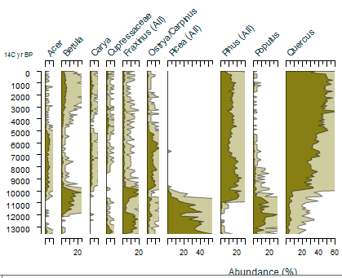
Neotoma Paleoecology DB: Design Concepts
Spatiotemporal database: species occurrences & abundances in space and time
Open data accessible via Explorer, APIs, R Neotoma
Curated by Community -> High-Value Data
Centralized IT and Distributed Scientific Governance. Neotoma composed of Constituent Databases (e.g. North American Pollen Database, FAUNMAP)
Age controls and age models stored
Controlled Vocabularies for variable names and taxonomy
Broad user community: Paleoecologists, ecosystem modellers, paleoclimatologists, biogeographers, educators, …
Neotoma DB
www.neotomadb.org

Slide 10
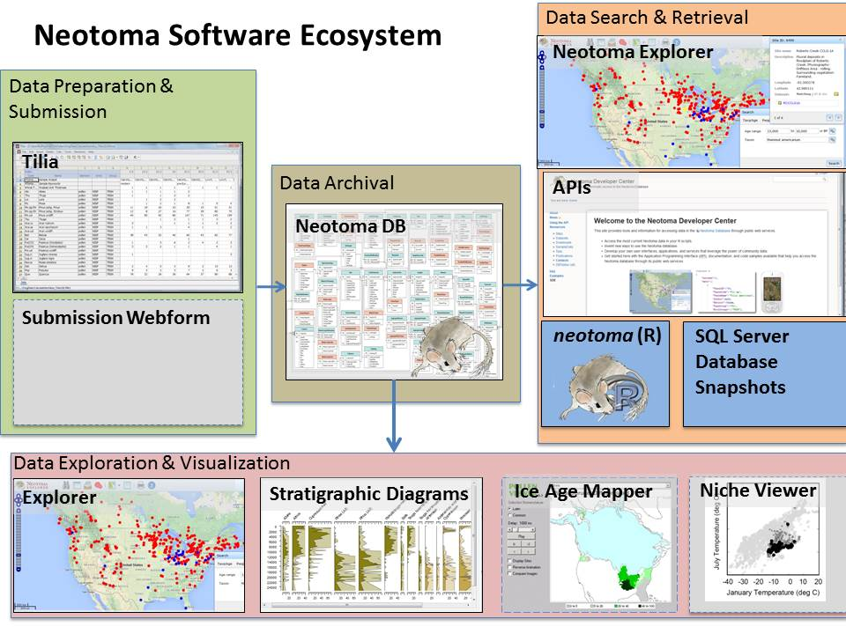
Neotoma Software Ecosystem

Slide 11
Neotoma Explorer (Finding/Exploring/Getting Data)
Neotoma DB
www.neotomadb.org
See also: Walk-Through Teaching Exercise, Neotoma Explorer
http://serc.carleton.edu/neotoma/activities.html

Slide 12
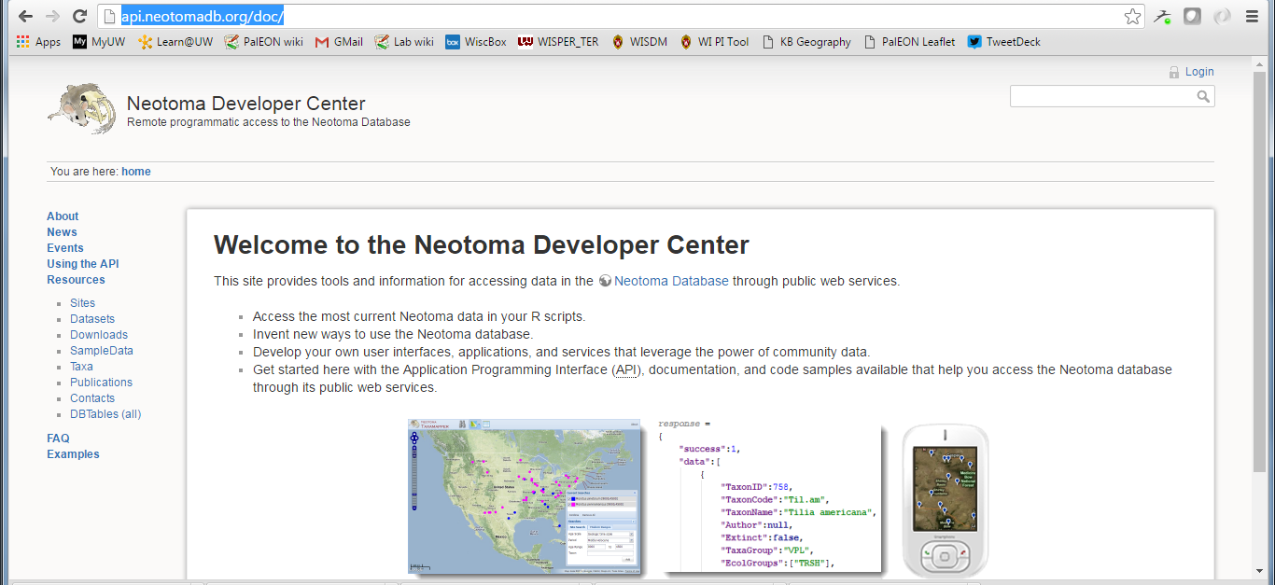
Neotoma APIs (Finding/Exploring/Getting Data)
Neotoma DB
www.neotomadb.org
APIs & Documentation available at:
http://api.neotomadb.org/doc/

Slide 13
Tilia (Putting Data into Neotoma)
Neotoma DB
www.neotomadb.org
Free Download: http://www.tiliait.com/download/
Manual:

Slide 14
Neotoma Resources
Neotoma APIs
http://api.neotomadb.org/doc/
Neotoma Explorer
http://apps.neotomadb.org/explorer/
Neotoma Manual, Design Concepts, etc.
http://neotoma-manual.readthedocs.io/en/latest/index.html
Walk-Through Teaching Exercise, Neotoma Explorer
http://serc.carleton.edu/neotoma/activities.html
Tilia
Download: http://www.tiliait.com/download/
Manual: http://tilia-manual.readthedocs.io/en/latest/
Neotoma R
Available at CRAN
Goring et al. 2015 Open Quaternary

Slide 15
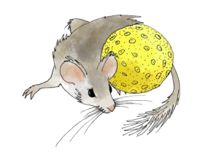
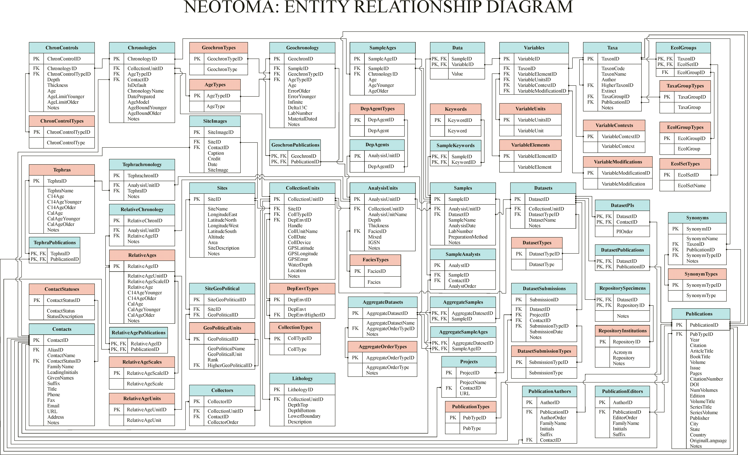
Neotoma Concepts & Database
Database Structure

Slide 16
Key Concepts: Sites, Collection Units, Analysis Units, Samples, Datasets
Sites
CollectionUnits
AnalysisUnits
Samples
Datasets
SiteID
SiteName
LongitudeEast
LatitudeNorth
LongitudeWest
LatitudeSouth
Altitude
Area
SiteDescription
Notes
CollectionUnitID
SiteID
CollTypeID
DepEnvtID
Handle
CollUnitName
CollDate
CollDevice
GPSLatitude
GPSLongitude
GPSError
WaterDepth
Location
Notes
AnalysisUnitID
CollectionUnitID
AnalysisUnitName
Depth
Thickness
FaciesID
Mixed
IGSN
Notes
SampleID
AnalysisUnitID
DatasetID
SampleName
AnalysisDate
LabNumber
PreparationMethod
Notes
DatasetID
CollectionUnitID
DatasetTypeID
DatasetName
Notes
One site may have many collection units
One collection unit may have many analysis units
One analysis unit may have many samples
A dataset comprises all samples of same type from same collection unit

Slide 17
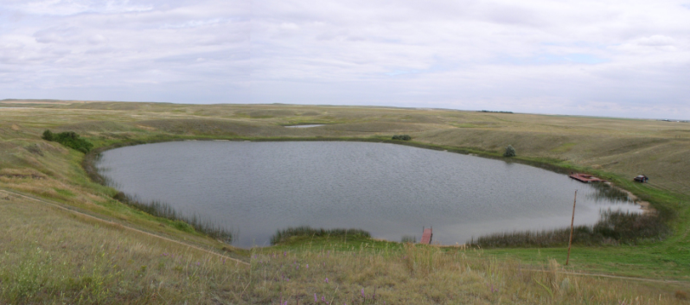
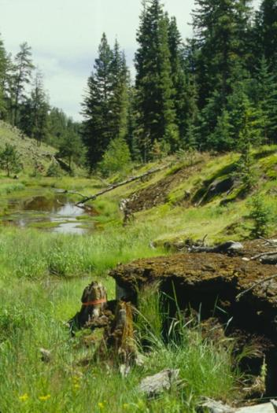
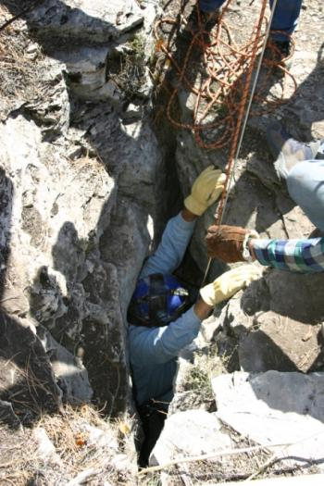
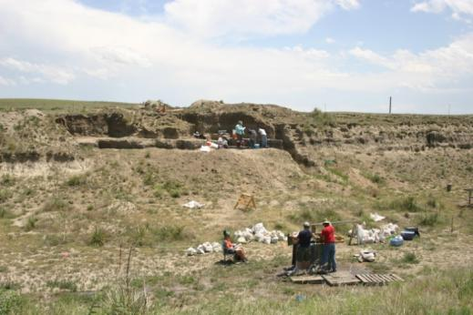
Sites
Sites Table
Lakes
SiteID
SiteName
LongitudeEast
LatitudeNorth
LongitudeWest
LatitudeSouth
Altitude
Area
SiteDescription
Notes
Sections
Caves
Archaeological Digs

Slide 18
Collection Units
Sites
CollectionUnits
Examples
Multiple cores w/in a lake
Multiple pits w/in an archaeological dig
Multiple bone piles within a cave
etc.
SiteID
SiteName
LongitudeEast
LatitudeNorth
LongitudeWest
LatitudeSouth
Altitude
Area
SiteDescription
Notes
CollectionUnitID
SiteID
CollTypeID
DepEnvtID
Handle
CollUnitName
CollDate
CollDevice
GPSLatitude
GPSLongitude
GPSError
WaterDepth
Location
Notes

Slide 19
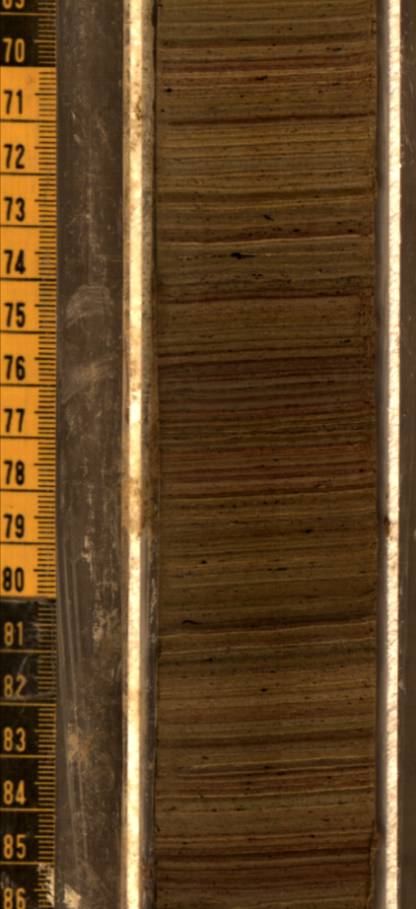
Analysis Units
CollectionUnits
AnalysisUnits
CollectionUnitID
SiteID
CollTypeID
DepEnvtID
Handle
CollUnitName
CollDate
CollDevice
GPSLatitude
GPSLongitude
GPSError
WaterDepth
Location
Notes
AnalysisUnitID
CollectionUnitID
AnalysisUnitName
Depth
Thickness
FaciesID
Mixed
IGSN
Notes
Analysis units have a depth and thickness
Example: depths within a sediment core

Slide 20
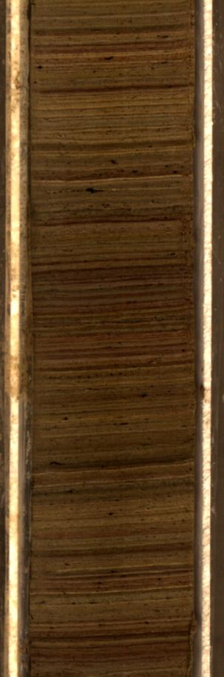
Samples
AnalysisUnits
Samples
AnalysisUnitID
CollectionUnitID
AnalysisUnitName
Depth
Thickness
FaciesID
Mixed
IGSN
Notes
SampleID
AnalysisUnitID
DatasetID
SampleName
AnalysisDate
LabNumber
PreparationMethod
Notes
Pollen
Charcoal
Diatoms
Loss-on-ignition
Example: pollen, charcoal, diatom samples from a single depth interval in a core

Slide 21
Chronologies and Age Models
The Neotoma data model for time is based on three related concepts
Age Controls
Age-Depth Models
Chronologies
Age
Controls
Age-Depth Models
Chronologies
… more about this on Friday

Slide 22
Part 1: Paleoecoinformatics & Community Curated Data Repositories
Part 2: Neotoma Paleoecology Database
Part 3: Scientific workflows and neotoma (R)

Slide 23

Paleodata Workflows: Linear or Cycles?
Consequences:
Variably documented data
Challenging project management
Multiple inefficiencies, sources of data friction
Synthetic research hard at anything beyond site scale
Cores Collected
Cores Split, Sampled, Logged
Proxies Measured by PIs
Papers Written
Data & Metadata Assembled
Data Deposited (Journals, NOAA-Paleo, Neotoma DB, Paleobio DB, etc.)
New Questions, Analyses
Metadata Gaps Discovered
Data Synthesized into Regional-Global Studies
C4P RCN
Neotoma DB
www.neotomadb.org

Slide 24
Next-Generation PaleoData Workflows
Cores Collected, Tagged with IGSNs, Metadata logged In field
Cores Split, Sampled, Logged, Samples assigned IGSNs, Data stored in common data structures (e.g. Open Core Data)
Proxies Measured by PIs, Embargoed data passed to CCDRs (e.g. Neotoma), DOIs minted
Multisite Syntheses, Joint analysis of embargoed data and public data
Papers Written, DOIs of embargoed data sent to publisher
Paper Published, Embargo lifted from repository
C4P RCN
Neotoma DB
www.neotomadb.org

Slide 25


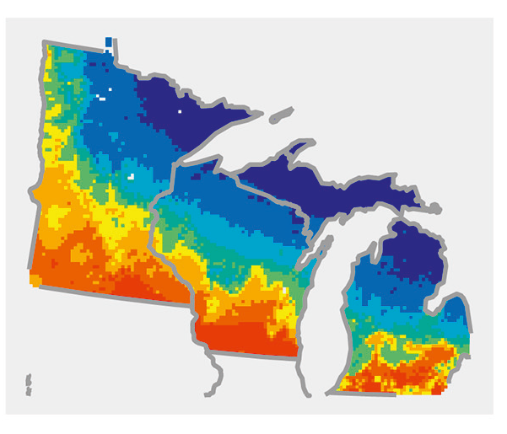

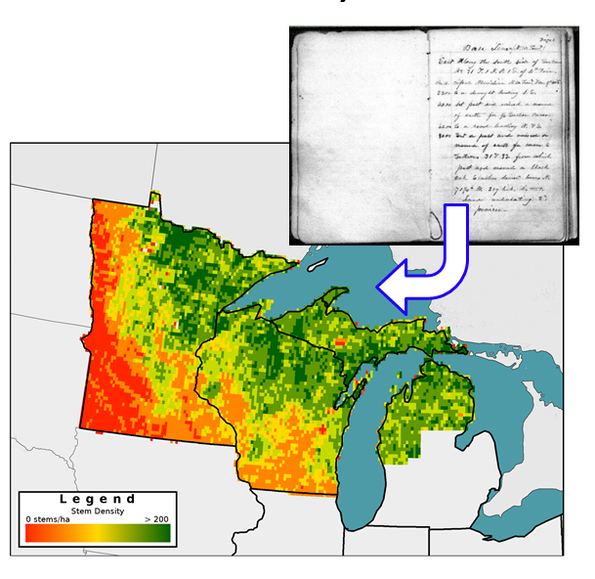
Reconstructing Vegetation for last 2 ka: Neotoma – PalEON integrated workflow
Data cleaning,
standardization,
upload
Individual Data Contributors
Hotchkiss, Calcote, & Lynch
Hupy & Yansa
Booth & Jackson
Cushing
St. Jacques
Neotoma DB
R
neotoma
Rebuild age
models (bacon)
STEPPS
Pollen
Paleoveg.
Witness Tree
Data
Reconstrux
w/ uncertainty
Vegetation
Goring et al. (2015) Open Quaternary
Goring et al. (in press) PLoS
Dawson et al. (2016) QSR

Slide 26
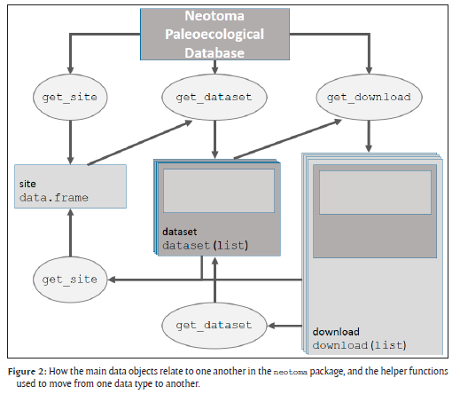
Neotoma R Porting Neotoma data to R environment
Key Functions
get_site
get_dataset
get_download
get_chroncontrol
get_table
get_taxa
Other Functions
get_closest
get_contact
get_publication
GitHub Repository: https://github.com/NeotomaDB/neotoma
Goring et al. 2015 Open Quaternary

Slide 28
Extra Slides

Slide 29
Paleoecoinformatics occupies the intersection among several informatics domains
Brewer et al 2012 TREE

Slide 30
Paleoecoinformatics: the collection, organization, analysis, synthesis, and curation of paleoecological data
Data Processing, Analysis, & Visualization
Data Collection
Data Archiving & Retrieval
Informatics: studying how to design a system that delivers the right information, to the right person in the right place and time, in the right way. (Wikipedia)

